Slide 1

Chapter 1. Overview and Descriptive Statistics
Weiqi Luo (骆伟祺)
School of Data & Computer Science
Sun Yat-Sen University
Email：luoweiqi@mail.sysu.edu.cn

Slide 2
Textbook:
  Jay L. Devore, Probability and statistics for engineering and the sciences (the 8th Edition), 2010
References:
  1. Miller and Freund, “Probability and Statistics for Engineers” (the 7th Edition), Publishing House of Electronics Industry, 2005.
2. 盛骤、谢式千、潘承毅，《概率论与数理统计》第4版，高等教育出版社，2008
Kai Lai Chung, “A Course in Probability Theory”, (the 3rd Edition), China Machine Press, 2010.

Slide 3
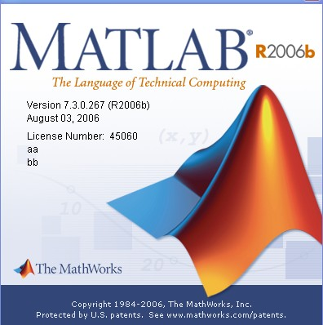
MATLAB
A powerful software with various toolboxes, including
Statistics Toolbox
Image Processing Toolbox
Signal processing Toolbox
Robust Control Toolbox
Curve Fitting Toolbox
Fuzzy Logic Toolbox
…

Slide 4
Prerequisite Courses
SE-101 Advanced Mathematics
SE-103 Linear Algebra
Successive Courses
SE-328 Digital Signal Processing
SE-343 Digital Image Processing
SE-352 Information Security
Pattern Recognition & Machine learning
etc.

Slide 5
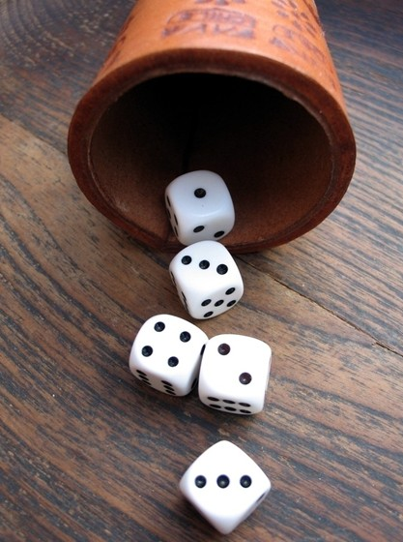
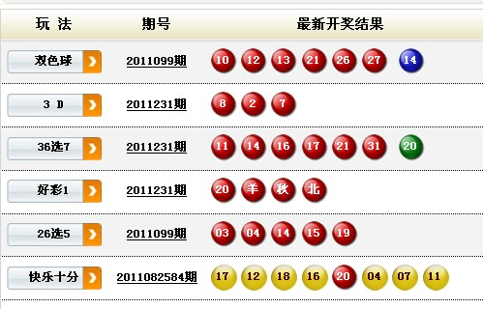
What is Uncertainty?
Uncertainty
It can be assessed informally using the language such as “it is unlikely” or “probably”.
This science came of gambling in 7th century

Slide 6
Why Study Probability & Statistics?
Probability measures uncertainty formally, quantitatively. It is the mathematical language of uncertainty.
Statistics show some useful information from the uncertain data, and provide the basis for making decisions or choosing actions.

Slide 7
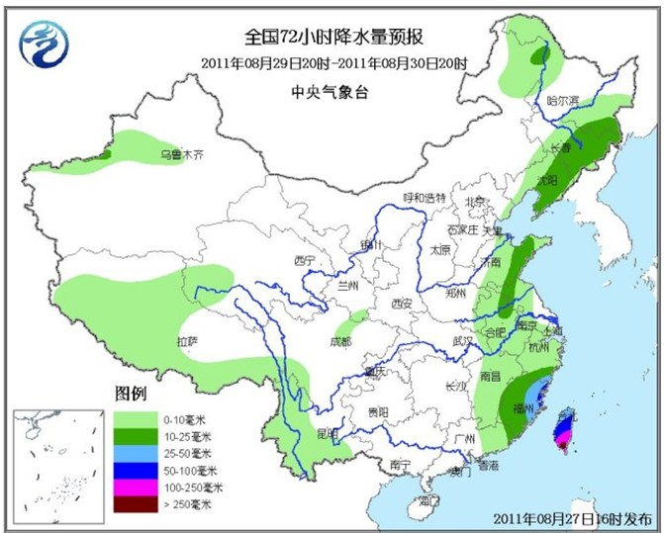
Applications
Weather Forecast

Slide 8

Applications
In medical treatment
e.g. Relationship between
smoking and lung cancer

Slide 9
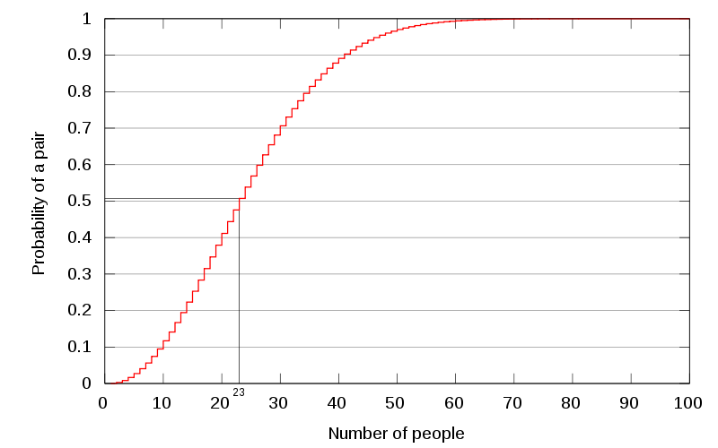
Applications
Birthday Paradox (from Wikipedia)

Slide 10
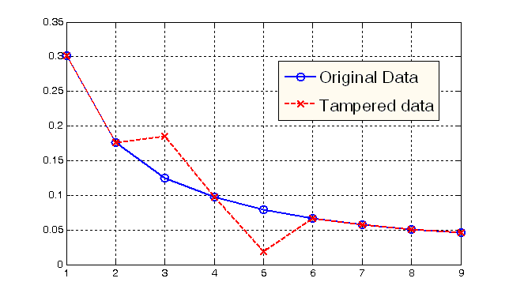
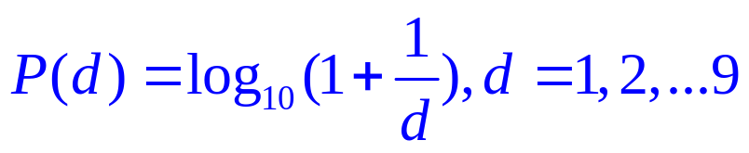
Applications
Benford’s Law/ First Digit Law (from Wikipedia)
Accounting Forensics
Multimedia Forensics
…

Slide 11
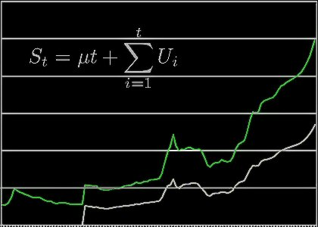
Applications
Time Series Analysis
Economic Forecasting
Sales Forecasting
Budgetary Analysis
Stock Market Analysis
Process and Quality Control
Inventory Studies
etc.

Slide 12

Applications
More interesting applications in real life
Millon 2 one (概率知多少):
https://www.youtube.com/watch?v=3RngSBNw1AE

Slide 13
Chapter 1: Overview & Descriptive Statistics
1.1. Populations, Samples, and Processes
1.2. Pictorial and Tabular Methods in Descriptive Statistics
1. 3 Measures of Location
1.4. Measures of Variability

Slide 14
1.1. Populations, Samples, and Processes
Population
An investigation will typically focus on a well-defined collection of objects (units). A population is the set of all objects of interest in a particular study.
Variables
Any characteristic whose value (categorical or numerical) may change from one object to another in the population.

Slide 15
1.1. Populations, Samples, and Processes
Examples of Populations, Objects and variables
Population | Unit / Object | Variables / Characteristics
All students currently in the class | Student | Height Weight Hours of work per week Right/left – handed
All Printed circuit boards manufactured during a month | Board | Type of defects Number of defects Location of defeats
All campus fast food restaurants | Restaurant | Number of employees Seating capacity Hiring/not hiring
All books in library | Book | Replacement cost Frequency of checkout Repairs needs

Slide 16
1.1. Populations, Samples, and Processes
Sample
A subset of the population
Selected in some
prescribed manner
Population
Sample

Slide 17
1.1. Populations, Samples, and Processes
According to the number of the variables under investigation, we have
Univariate : a single variable, e.g.
the type of transmission, automatic or manual, on cars
Bivariate : two variables, e.g.
the height & weight of the students
Multivariate : more than two variables, e.g.
systolic blood pressure, diastolic blood pressure and serum cholesterol level for each patient

Slide 18
1.1. Populations, Samples, and Processes
Descriptive statistics
An investigator who has collected data may wish simply to summarize and describe important features of the data. (descriptive statistics)
Visual techniques (Sec. 1.2), e.g.
Stem-and-Leaf display, Dotplot & histograms
Numerical summary measures (Sec. 1.3, 1.4), e.g.
means, standard deviations & correlations coefficients

Slide 19
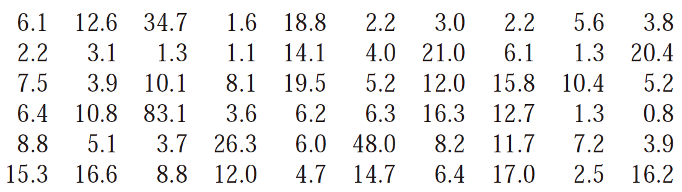
1.1. Populations, Samples, and Processes
Example 1.1.
Here is data on fundraising expenses as a percentage of
total expenditures for a random sample of 60 charities:
Without any organization, it is difficult to get a sense of the data’s most prominent features

Slide 20
1.1. Populations, Samples, and Processes
Inferential statistics
Use sample information to draw some type of conclusion (make an inference of some sort) about the population.
Point Estimation ---- Chapter 6
Hypothesis testing ---- Chapter 8
Estimation by confidence interval --- Chapter 7
…

Slide 21
1.1. Populations, Samples, and Processes
Probability & Statistics
Deductive Reasoning
(Probability)
Population
Sample
Inductive Reasoning
(Inferential Statistics)
The mathematical language is “Probability”

Slide 22
1.1. Populations, Samples, and Processes
Collecting Data
If data is not properly collected, an investigator may not be able to answer the questions under consideration with a reasonable degree of confidence.
Methods for collecting data
Random sampling: any particular subset of the specified size has the same chance of being selected
Stratified sampling: entails separating the population units into non-overlapping groups and taking a sample from each one.
So on and so forth

Slide 23
Descriptive Statistics
Visual techniques (Sec. 1.2)
Stem-and-Leaf Displays
Dotplots
Histogram
Numerical summary measures (Sec. 1.3 & 1.4)
Measures of location
Measure of variability

Slide 24
1.2 Pictorial and Tabular Method in Descriptive Statistics
Notation
Sample size: The number of observations in a single sample will often be denoted by n.
Given a data set consisting of n observations on some variable x, the individual observations will be denoted by x₁, x₂, x₃,…, x_{n}

Slide 25
1.2 Pictorial and Tabular Method in Descriptive Statistics
Stem-and-Leaf Displays
Suppose we have a numerical data set x₁,x₂,x₃,…,x_{n} for which each x_{i} consists of at least two digits.
Steps for constructing a Stem-and-Leaf Display
Select one or more leading digits for the stem values. The trailing digits become the leaves.
List possible stem values in a vertical column.
Record the leaf for every observation beside the corresponding stem value.
Indicate the units for stems and leaves someplace in the display.

Slide 26
1.2 Pictorial and Tabular Method in Descriptive Statistics
Example:
Observations: 16%, 33%, 64%, 37%, 31% …
Stem-and-Leaf Display
Stem | Leaf
1 | 6
3 | 3 7 1 [or 3 | 1 3 7]
6 | 4
Stem: tens digit
Leaf: ones digit

Slide 27
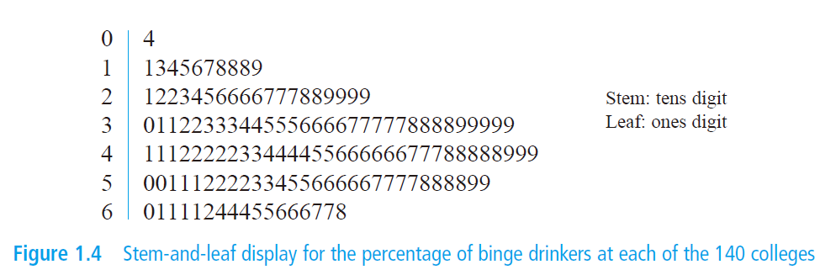
1.2 Pictorial and Tabular Method in Descriptive Statistics
Example 1.6

Slide 28
1.2 Pictorial and Tabular Method in Descriptive Statistics
A stem-and-leaf display conveys information about the following aspects of the data:
Identification of a typical or representative value
Extent of spread about the typical value
Presence of any gaps in the data
Extent of symmetry in the distribution of values
Number and location of peaks
Presence of any outlying values

Slide 29
1.2 Pictorial and Tabular Method in Descriptive Statistics
Example
Stem: Thousands and hundreds digits
Leaf: Tens and ones digits
| 35 64 33 70
| 26 27 06 83
| 05 94 14
| 90 70 00 98 70 45 13
| 90 70 73 50
| 00 27 36 04
| 51 05 11 40 50 22
| 31 69 68 05 13 65
| 80 09
| 435 464 433 470 … 904
| 051 005 011 040 … 209
Stem: Thousands digits
Leaf: Hundreds, tens and ones digits

Slide 30
1.2 Pictorial and Tabular Method in Descriptive Statistics
Example (repeated stems)
5H | 5
5L | 242330
4H | 768896
4L | 21421414444
3H | 9696656
=
5 | 242330 5
| 21421414444 768896
3 | 9696656
Stem: tens digit
Leaf: ones digit
Stem: tens digit
Leaf: ones digit
Note: L: the leafs are 0, 1 , 2, 3 or 4
H: the leafs are 5, 6, 7, 8 or 9

Slide 31
1.2 Pictorial and Tabular Method in Descriptive Statistics
Dotplot
the data set is reasonably small or there are relatively few distinct data values
Each observation is represented by a dot above the corresponding location on a horizontal measurement scale.
When a value occurs more than once, there is a dot for each occurrence, and these dots are stacked vertically.
As with a stem-and-leaf display, a dotplot gives information about location, spread, extremes & gaps.

Slide 32
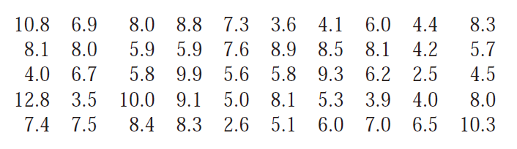
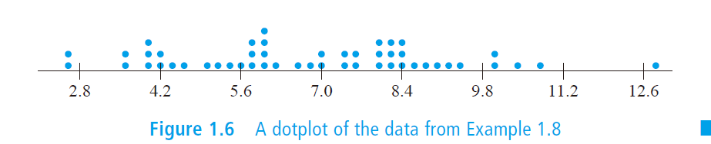
1.2 Pictorial and Tabular Method in Descriptive Statistics
Example 1.8

Slide 33
1.2 Pictorial and Tabular Method in Descriptive Statistics
Histogram
Types of variables:
Discrete variable: A variable is discrete if its set of possible values either is finite or else can be listed in an infinite sequence.
Continuous variable: A variable is continuous if its possible values consist of an entire interval on the number line.

Slide 34
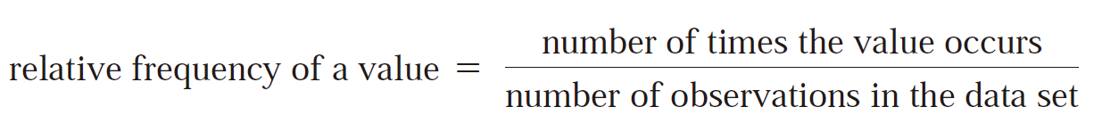
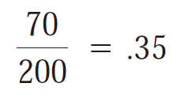
1.2 Pictorial and Tabular Method in Descriptive Statistics
Relative frequency of a value
Suppose, for example, that our data set consists of 200 observations on of courses a college student is taking this term. If 70 of these x values are 3, then
frequency of the x value 3: 70
Relative frequency of the x value 3:

Slide 35
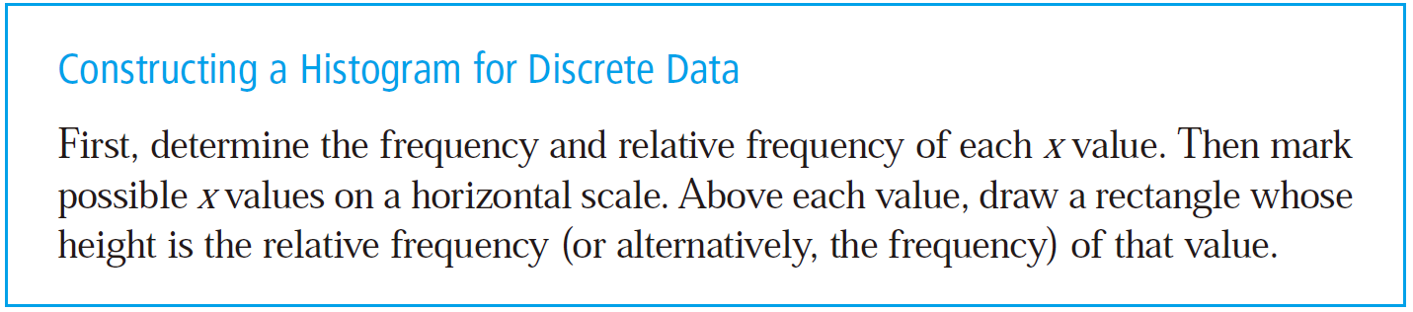
1.2 Pictorial and Tabular Method in Descriptive Statistics

Slide 36
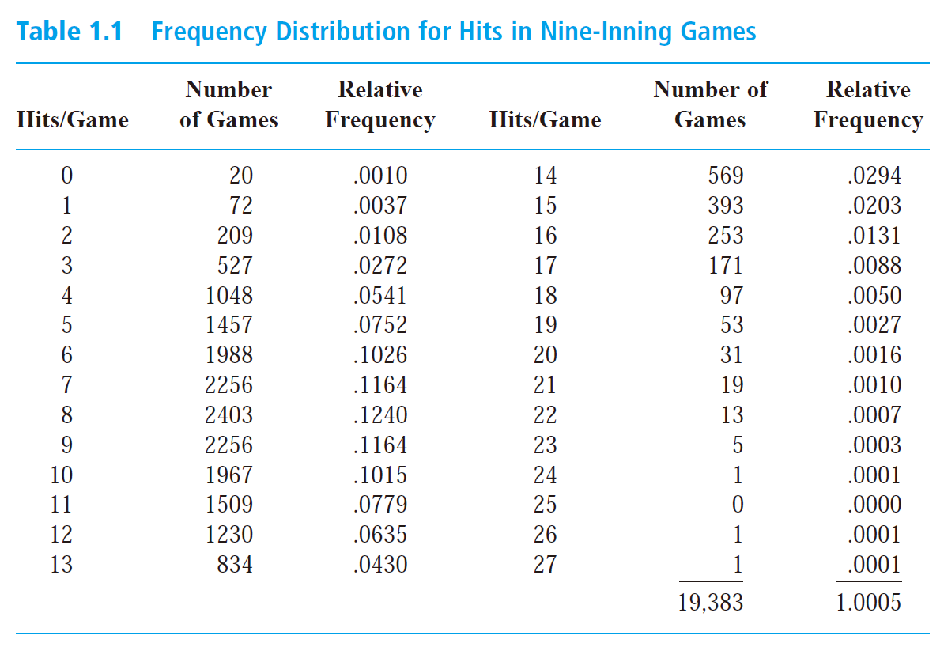
1.2 Pictorial and Tabular Method in Descriptive Statistics
Example 1.9
Why not 1?

Slide 37
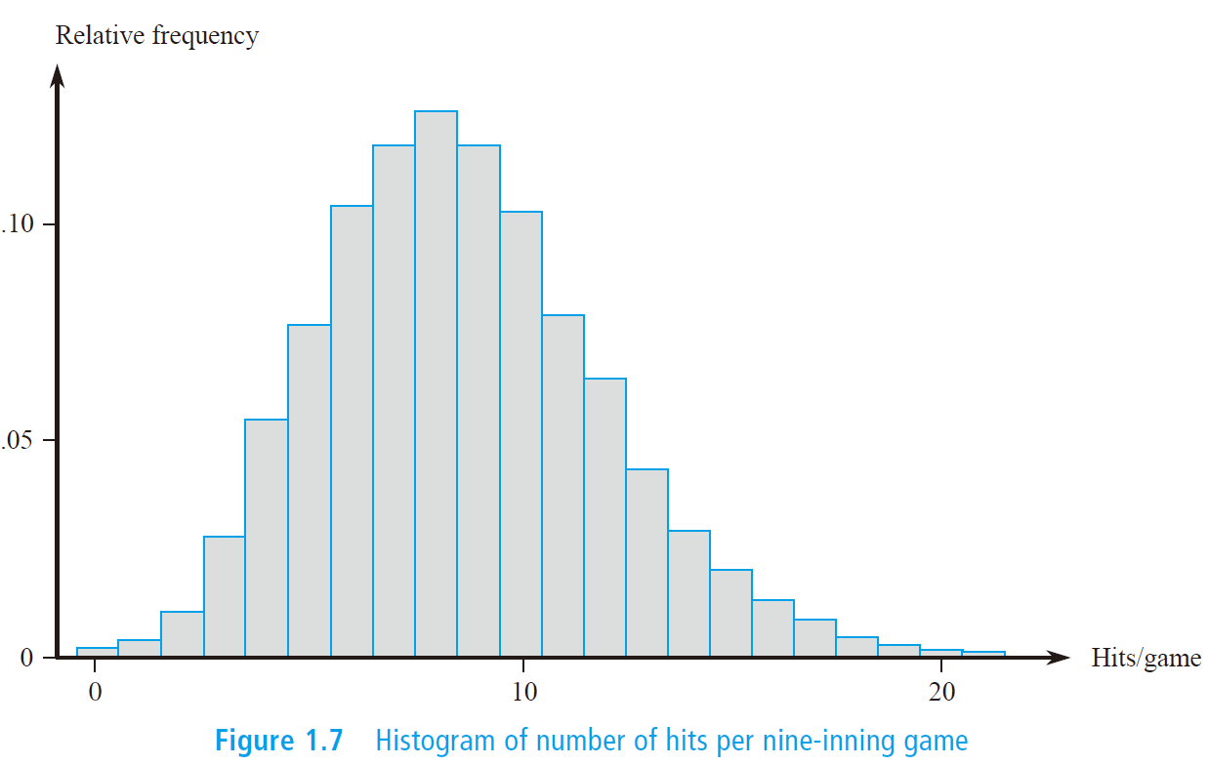
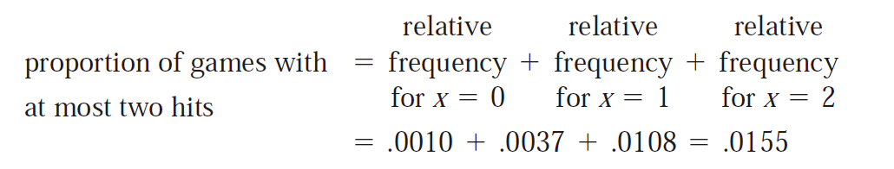
1.2 Pictorial and Tabular Method in Descriptive Statistics
Example 1.9

Slide 38
1.2 Pictorial and Tabular Method in Descriptive Statistics
Continuous Case
p17. Support that we have 50 observations on x=fuel efficiency of an automobile (mpg), the smallest of which is 27.8 and the largest of which is 31.4
Equal or Unequal width
Class intervals : Continues ➔ Discrete
27.5
28.0
28.5
29.0
29.5
30.0
30.5
31.0
31.5
Each observation is contained in exactly one class

Slide 39
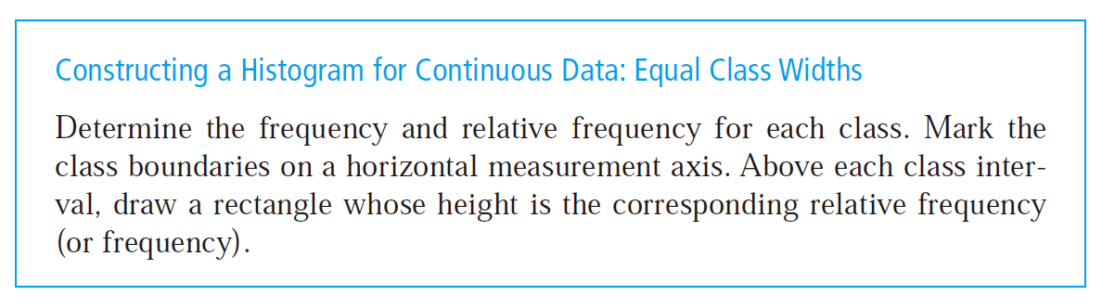

Slide 40
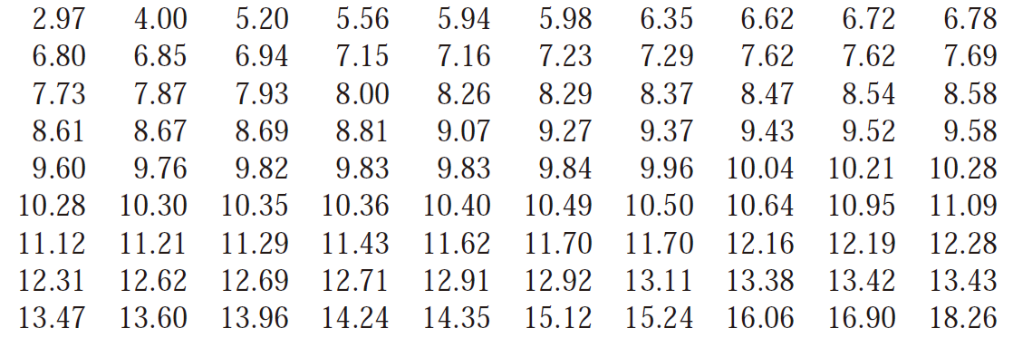
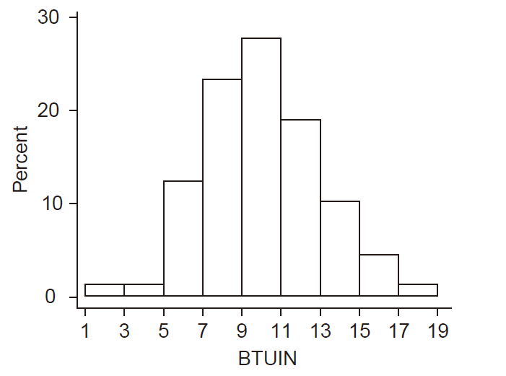
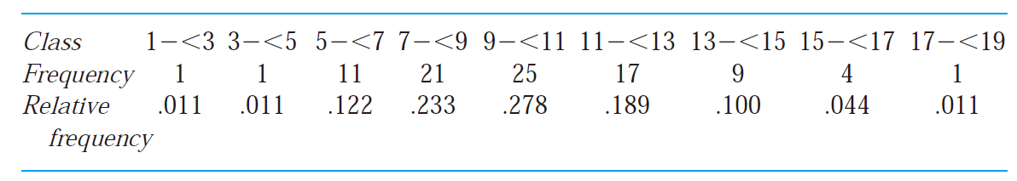
1.2 Pictorial and Tabular Method in Descriptive Statistics
Example 1.10

Slide 41
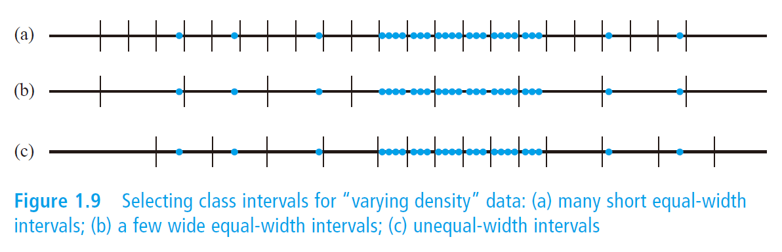
1.2 Pictorial and Tabular Method in Descriptive Statistics
Equal-width classes may not be a sensible choice if there are some regions of the measurement scale that have a high concentration of data values and other parts where data is quite sparse.

Slide 42
1.2 Pictorial and Tabular Method in Descriptive Statistics
Constructing a Histogram for Continuous Data : Equal (or Unequal) Class Widths
Make sure that:
class width × rectangle height (density)
= relative frequency of the class
That is, the area of each rectangle is the relative frequency of the corresponding class.
Furthermore, since the sum of relative frequencies should be 1, the total area of all rectangles in a density histogram is l.

Slide 43
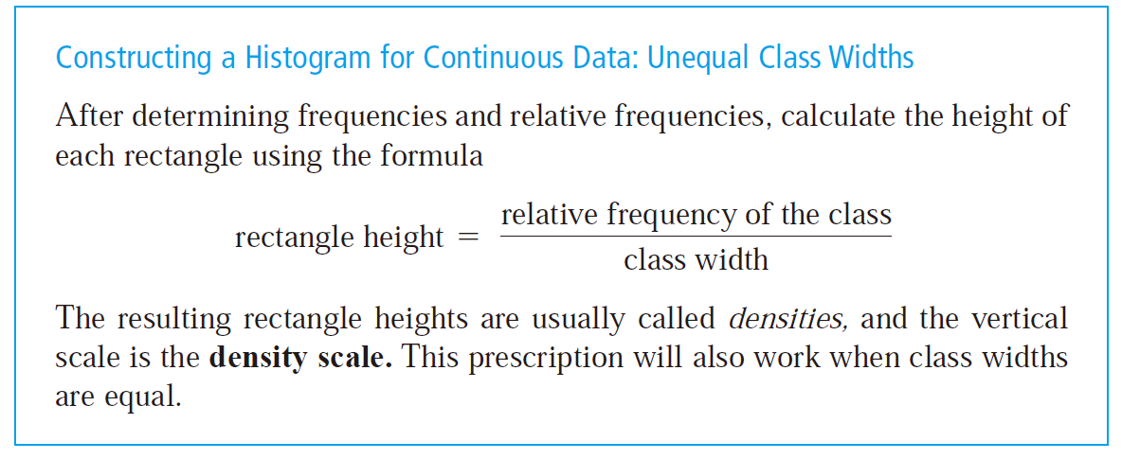
1.2 Pictorial and Tabular Method in Descriptive Statistics

Slide 44
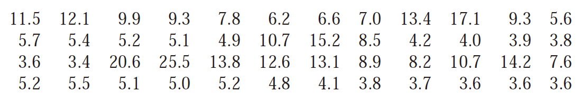
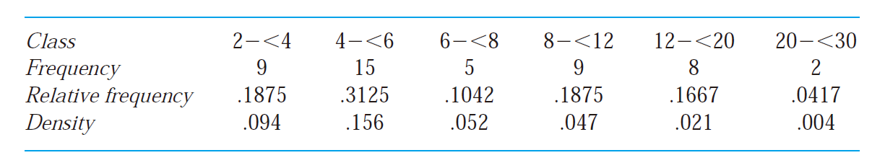
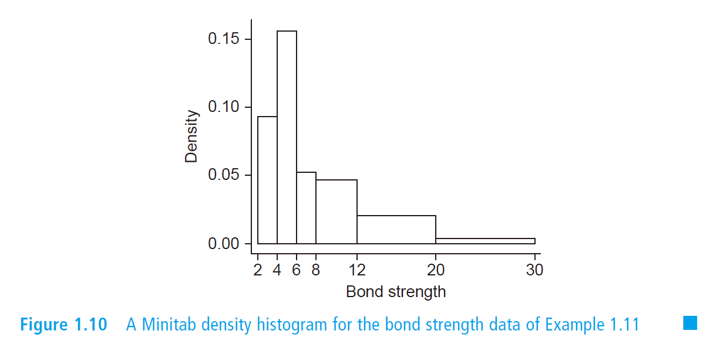
1.2 Pictorial and Tabular Method in Descriptive Statistics
Example 1.11

Slide 45
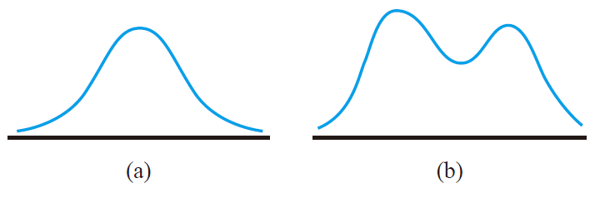
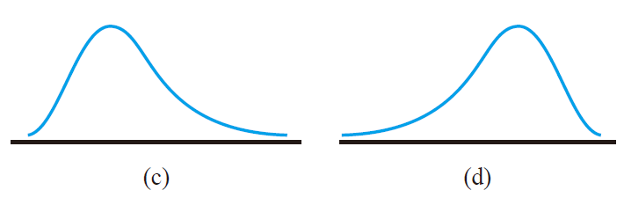
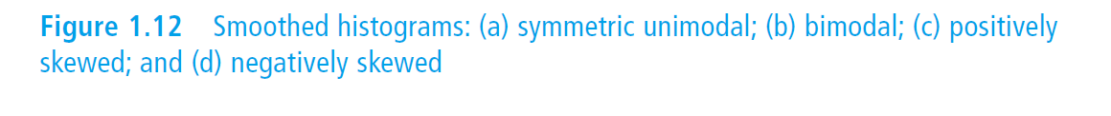
1.2 Pictorial and Tabular Method in Descriptive Statistics
Typical Histogram Shapes

Slide 46
1.2 Pictorial and Tabular Method in Descriptive Statistics
Qualitative Data
Both a frequency distribution and a histogram can be constructed when the data set is qualitative (categorical) in nature.
In some cases, there will be a natural ordering of classes—for example, freshmen, sophomores, juniors, seniors, graduate students
In other cases the order will be arbitrary—for example, Catholic, Jewish, Protestant, and the like.
With such categorical data, the intervals above which rectangles are constructed should have equal width

Slide 47
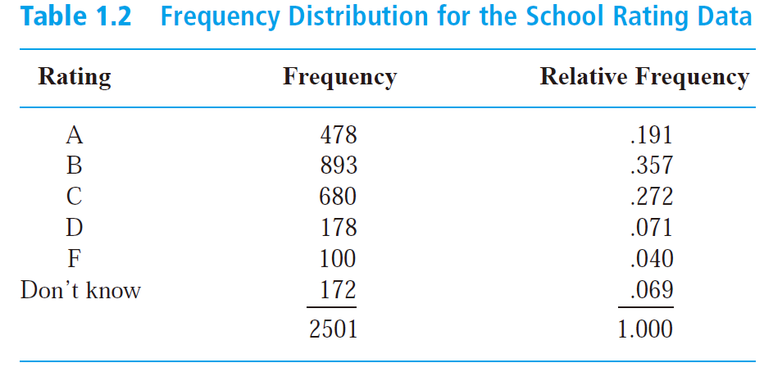
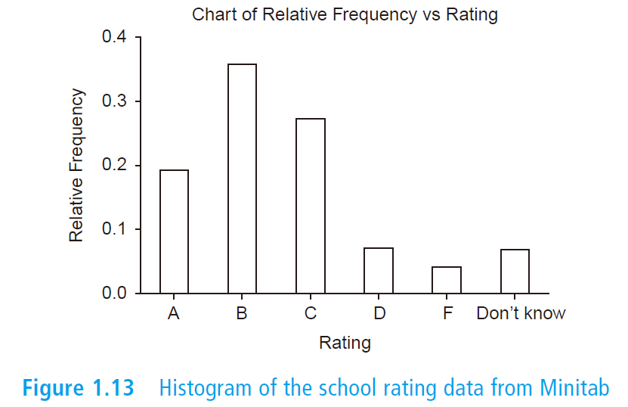
1.2 Pictorial and Tabular Method in Descriptive Statistics
Example 1.13

Slide 48
1.2 Pictorial and Tabular Method in Descriptive Statistics
Multivariate Data
The above mentioned techniques have been exclusively for situations in which each observation in a data set is either a single number or a single category.
Please refer to Chapters 11-14 for analyzing multivariate data sets.

Slide 49
Homework
Ex. 14, 19, 23, 27

Slide 50
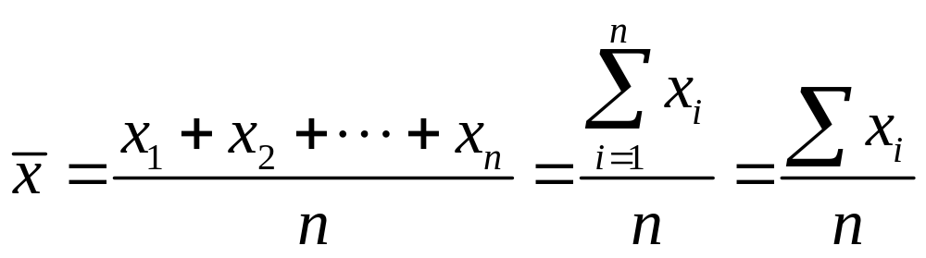
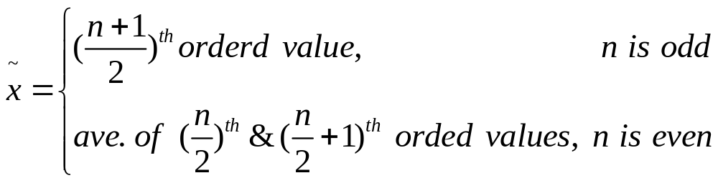
1.3 Measures of Location
The Mean
Sample mean: The sample mean of observations x₁, x₂, … , x_{n} is given by
Sample median: The sample media is obtained by first ordering the n observations from smallest to largest. Then

Slide 51
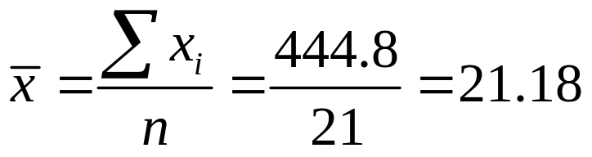

1.3 Measures of Location
Example 1.14 (Sample mean)
x₁=16.1 x₂=9.6 x₃=24.9 x₄=20.4 x₅=12.7 x₆=21.2 x₇=30.2
x₈=25.8 x₉=18.5 x₁₀=10.3 x₁₁=25.3 x₁₂=14.0 x₁₃=27.1 x₁₄=45.0
x₁₅=23.3 x₁₆=24.2 x₁₇=14.6 x₁₈=8.9 x₁₉=32.4 x₂₀=11.8 x₂₁=28.5
0H | 96 89
1L | 27 03 40 46 18
1H | 61 85
2L | 49 04 12 33 42
2H | 58 53 71 85
3L | 02 24
3H |
4L |
4H | 50
Outlying value
10
20
30
40

Slide 52
1.3 Measures of Location
Example (Median)
x₁=15.2 x₂=9.3 x₃=7.6 x₄=11.9 x₅=10.4 x₆=9.7
x₇=20.4 x₈=9.4 x₉=11.5 x₁₀=16.2 x₁₁=9.4 x₁₂=8.3
The list of ordered valued is
7.6 8.3 9.3 9.4 9.4 9.7 10.4 11.5 11.9 15.2 16.2 20.4
n = 12 is even, then the sample median is
(9.7 +10.4) / 2 = 10.05
Note: the sample mean here is 139.3/12 = 11.61.

Slide 53
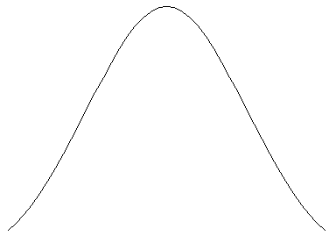
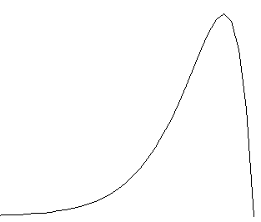
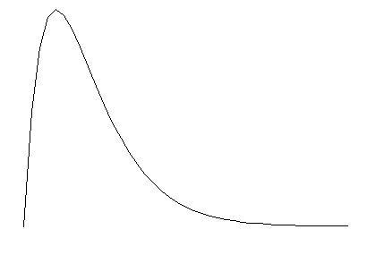
1.3 Measures of Location
Three different sharps for a population distribution
Symmetric Unimodal
u: Population mean
~
u: Population median
Why?
~
u=
u
Negative
Skewed
Positively
Skewed
u
~
~
u
u
u

Slide 54
1.3 Measures of Location
Other Measures of Location
Quartiles
Percentiles
Quartiles
…
Median
1%
…
May be outlying data

Slide 55
1.4 Measures of Location
Trimmed Means
A trimmed mean is a compromise between sample mean & sample median. A 10% trimmed mean, for example, would be computed by eliminating the smallest 10% and the largest 10% of the sample and then averaging what is left over.
10%
10%
…
Sample Mean

Slide 56
1.4 Measures of Location
Example
612 623 666 744 883 898 964 970 983 1003
1016 1022 1029 1058 1085 1088 1122 1135 1197 1201
_
X_{tr(10)}
Removal
Removal
600
800
1000
1200
_
x
~
x
Note: Trimming proportion: 5%~25%

Slide 57
Homework
Ex. 36, 40, 41

Slide 58
1.4 Measures of Variability
Time error for three types of watches
9 observations for each type
1
* * * * * * * * *
2
3
-20
-10
0
+10
+20
Q: Which type is the best ? And why?

Slide 59
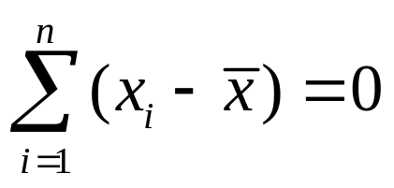
1.4 Measures of Variability
The Range
The difference between the largest and smallest sample values. Refer to the previous example, type 1 and 2 have identical ranges, however, there is much less variability in the second sample than in the first.
Deviations from the mean
Measure 1: x₁-mean, x₂-mean, …, x_{n}-mean, then for all cases

Slide 60
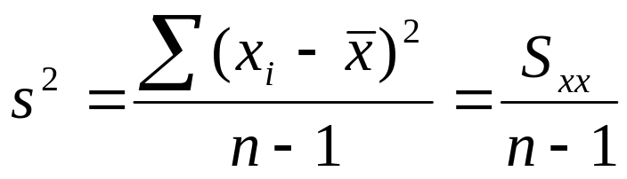


1.4 Measures of Variability
Sample variance
The sample variance, denoted by s², is given by
The sample standard deviation, denoted by s, is the square root of the variance s=sqrt(s²).
Q1: vs.
Q2: n-1 vs. n

Slide 61
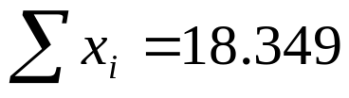
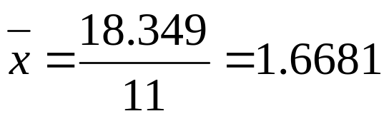

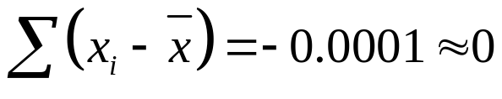
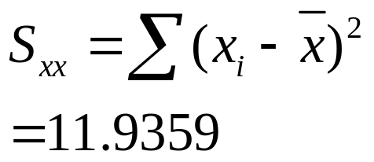
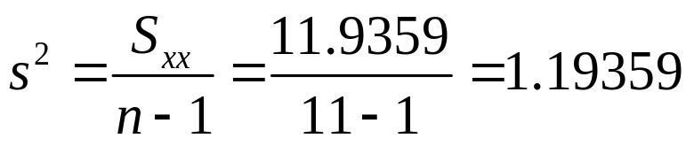
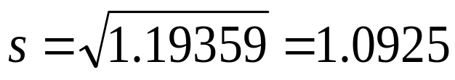
1.4 Measures of Variability
Example
x_{i} | x_{i} - | (x_{i}- )²
0.684 | 0.9841 | 0.9685
2.54 | 0.8719 | 0.7602
0.924 | -0.7441 | 0.5537
3.13 | 1.4619 | 2.1372
1.038 | -0.6301 | 0.3970
0.598 | -1.0701 | 1.1451
0.483 | -1.1851 | 1.4045
3.52 | 1.8519 | 3.4295
1.285 | -0.3831 | 0.1468
2.65 | 0.9819 | 0.9641
1.497 | -0.1711 | 0.0293

Slide 62
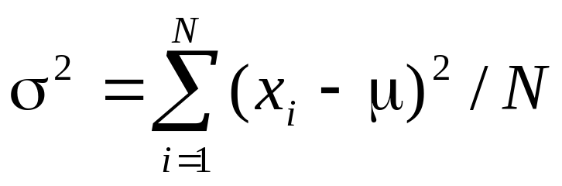
1.4 Measures of Variability
Population variance
We will use σ² to denote the population variance and σ to denote the population standard deviation. When the population is finite and consists of N values,

Slide 63
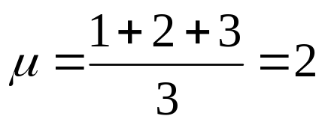
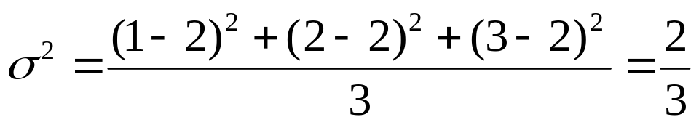
1.4 Measures of Variability
Consider a population with just 3 elements {1,2,3}
The mean of the population is
And the variance
Suppose all we can take is a sample of 2 elements taken with repetition to learn about the population.
  We would like the sample to accurately estimate the mean and variance values of the population.

Slide 64
1.4 Measures of Variability
Possible Samples of Size Two | Sample mean ‾x | s² using n =2 | s² using n – 1 = 1
{1,1} | 1 | 0/2 | 0/1
{2,2} | 2 | 0/2 | 0/1
{3,3} | 3 | 0/2 | 0/1
{1,2} | 1.5 | .5/2 = .25 | .5/1 = .5
(2,1) | 1.5 | .5/2 = .25 | .5/1 = .5
{1,3} | 2 | 2/2 = 1.0 | 2/1 = 2
(3,1) | 2 | 2/2 = 1.0 | 2/1 = 2
{2,3} | 2.5 | .5/2 = .25 | .5/1 = .5
(3,2) | 2.5 | .5/2 = .25 | .5/1 = .5
Average of Sample Statistics | 2 | 1/3 | 2/3
Better estimation!

Slide 65
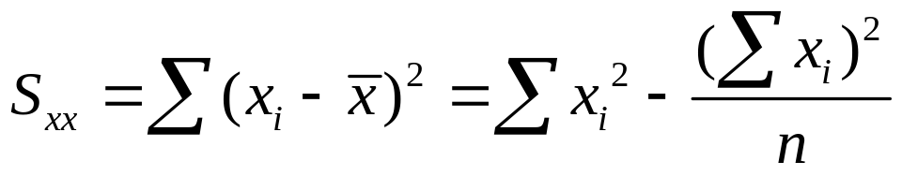
1.4 Measures of Variability
An alter expression for the numerator of s²
If y₁=x₁+c, y₂=x₂+c,…, y_{n}=x_{n}+c, then s_{y}²=s_{x}²
If y₁=cx₁,y₂=cx₂,…..,y_{n}=cx_{n}, then s_{y}²=c²s_{x}², s_{y}=|c|s_{x},
where s_{x}² is the sample variance of the x’s and s_{y}² is the sample variance of the y’s.
Be care of the rounding errors when using the two different expressions

Slide 66
1.4 Measures of Variability
Boxplots
Describe several of a data set’s most prominent features:
center;
spread;
extent and nature of any departure from symmetry ;
identification of “outliers ”, observations that lie unusually far from the main body of the data.

Slide 67
1.4 Measures of Variability
Fourth Spread
Order the n observations from smallest to largest and separate the smallest half from the largest half; the median is included in both halves if n is odd. Then the lower fourth is the median of the smallest half and the upper fourth is the median of the largest half. A measure of spread that is resistant to outliers is the fourth spread f_{s}, given by
f _{s} =upper fourth-lower fourth

Slide 68
1.4 Measures of Variability
The simplest boxplot is based on the 5-number summary
fs
Lower forth
Upper forth
Median
Smallest x_{i}
Largest x_{i}
The smallest 25% & The largest 25%

Slide 69


1.4 Measures of Variability
Example 1.19

Slide 70
1.4 Measures of Variability
A boxplot can be embellished to indicate explicitly the presence of outliers.
Outlier: Any observation father than 1.5 fs from the closest fourth is an outlier.
Extreme: An outlier is extreme if it is more than 3 fs from the nearest fourth
Mild: An outlier is mild if it is in the range of (1.5fs , 3fs] from the nearest fourth.

Slide 71



1.4 Measures of Variability
Example 1.20

Slide 72
Homework
Ex. 44, 54

